Slide 1

Semi-Annual Onboarding Session for P&E
Presented by
Product & Engineering Org + Partners
2021

Slide 2
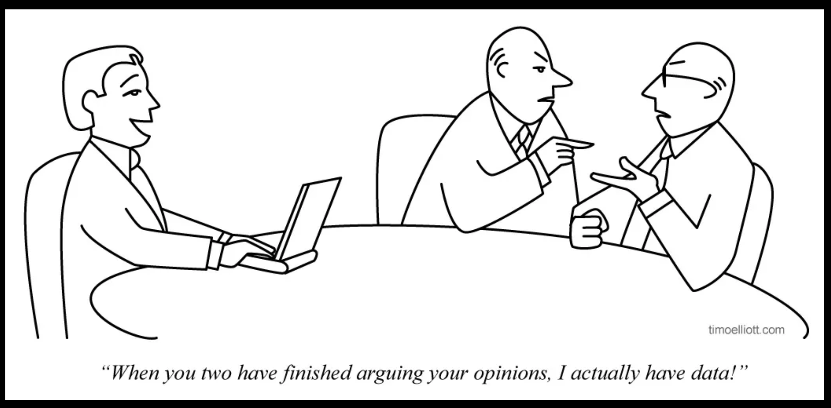
Ad Tracking
Insert Image Here

Slide 3








Ad Tracking Team
PO
Dev
QE
Nivedita Kanakoor
Zin Lim
Ganesh Lyamperumal
Suma Milli
Nikhil Kamthe
Rekha Mathew
Gowtham Rajasekaran
Nandini Tammisetti

Slide 4
Agenda
Overview of buyer side tracking for PL families of products (PLS, PLA, PLX, OA, PD).
Data Usage
Reporting on SellerHub: mTab, pTab, etc.
Attribution, Charging
Data science pipeline: Merch, Search.
Analytic, EP (MADCDL)
Data creation and collection
Impression, Clicks, Sale
Not in scope
Organic Data Tracking, Reporting
Notes:
“It is a capital mistake to theorize before one has data.” ~Sherlock Holmes by Arthur Conan Doyle. It is important to understand data and use data driven decisions in software development. Please join us to learn how advertising data on various SellerHub pages (mTab, pTab) are created and collected. Moreover, learn more about the advertising data pipeline, challenges, and future improvements.

Slide 5
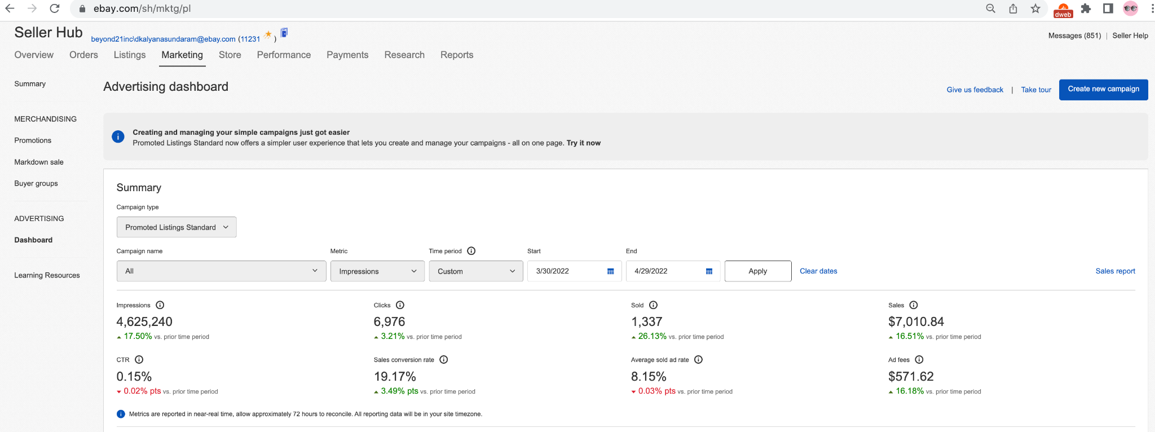
Data Usage: Marketing Tab

Slide 6
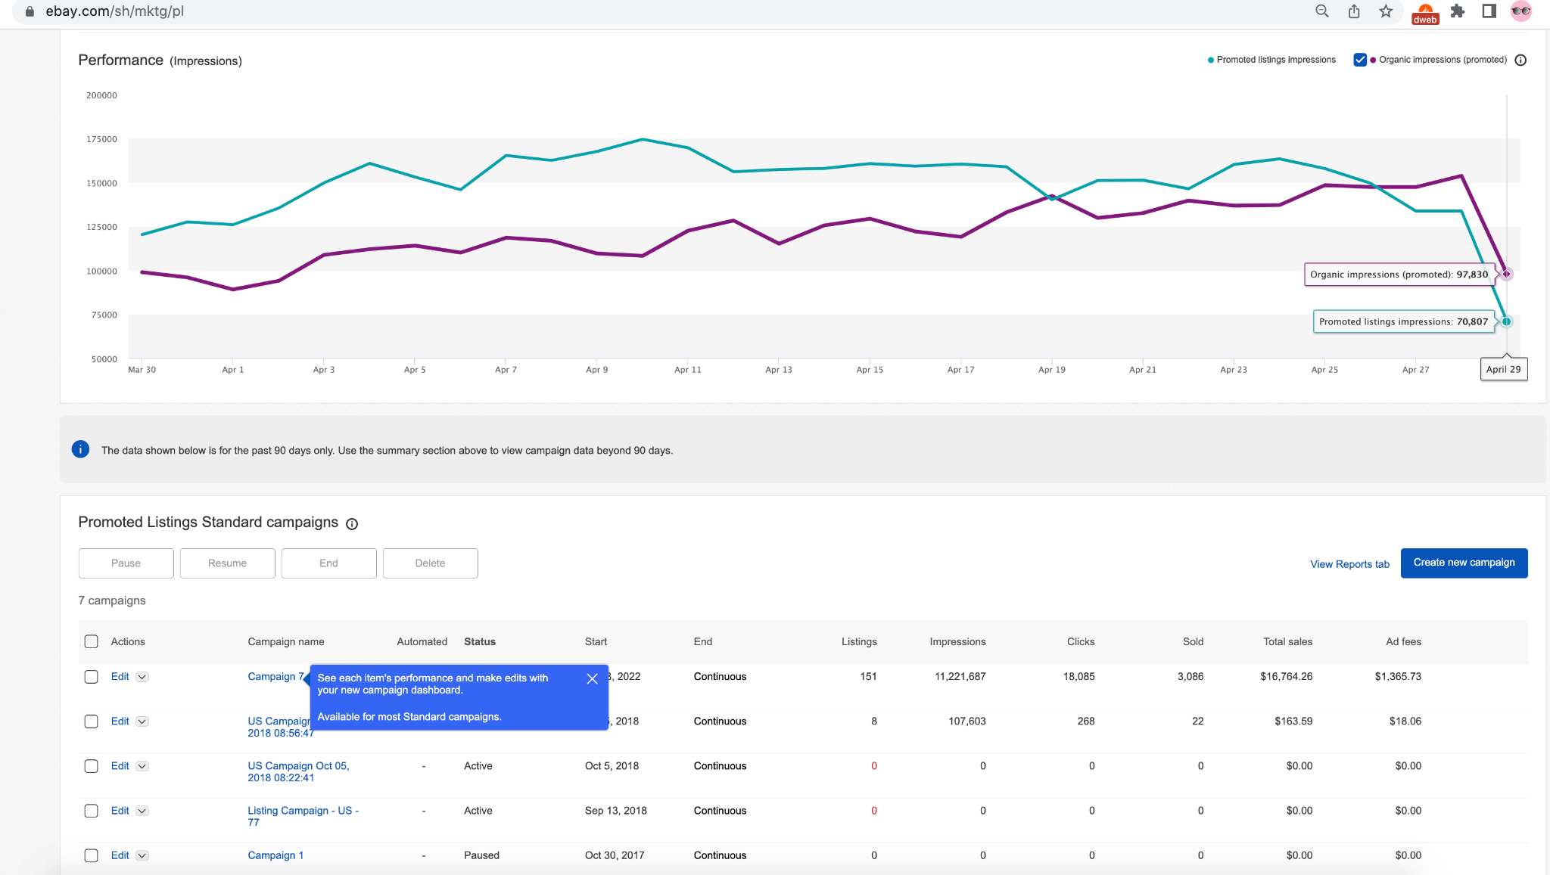
Data Usage: Marketing Tab

Slide 7
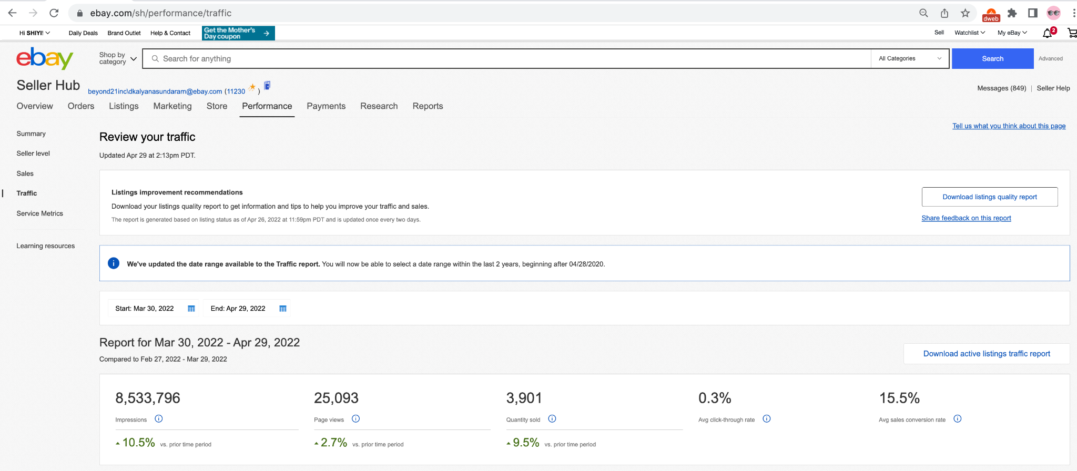
Data Usage: Performance Tab, Traffic Page

Slide 8
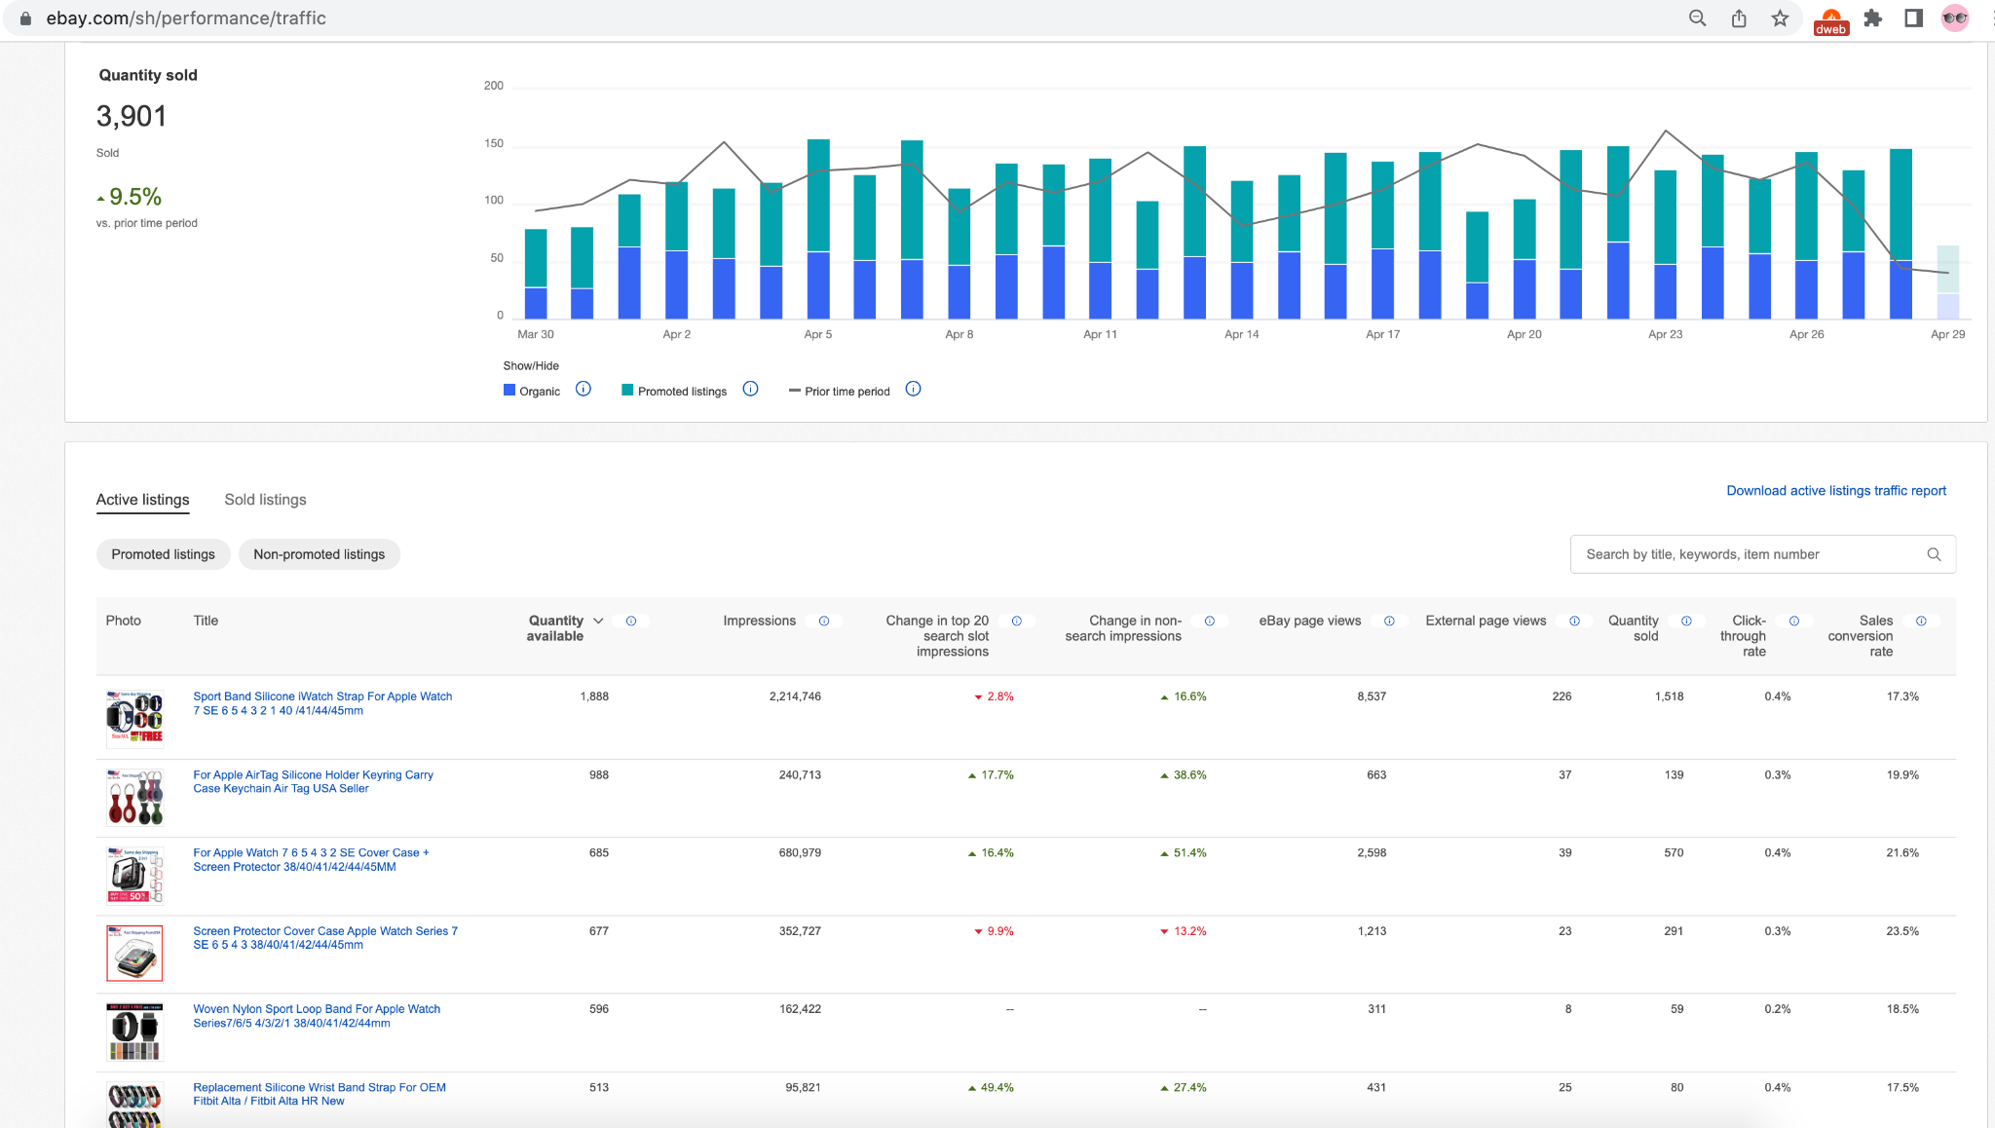
Data Usage: Performance Tab, Traffic Page

Slide 9
Data Usage: Attribution, Charging, Click Fraud
Attribution
Last Click attribution for PLS, PLA, PLX based on BES Click Events
Offline Soj xID attribution
Budget Management & Charging (CPC)
PLA/SFA(OA)/PD real time budget management
PLA/SFA(OA)/PD offline charging
Click Fraud (CPC)
PLA/SFA(OA)/PD Realtime Click Fraud processing on pulsar event.
Offline Click Fraud processing and Google Data Calibration (SFA)

Slide 10
Data Usage: Data Science, Analytic
Data Science pipeline
Merch Data Science Pipeline: Simplex
Search Data Science Pipeline: IMA (Item Metric Aggregator)
Analytic
MADCDL (PL Merch Data Table - DSS ETL)
UBI event table

Slide 11




Web
Native
Collection Services
Data Infrastructure
eBay Infrastructure Native Collection Services
Realtime
Offline
BES
Soj Bot
Filtering
BatchTrack
Rheos
Soj Bot
Filtering
Hadoop
Marketing
collection svc
Ads Tracking Lib
eBay Web Infrastructure
eBay Infrastructure Web Collection Services
Data Consumers
UFES-LB
UFES-SvcPool
PulsarProxy/
Andes
EdgeTrack
Click Fraud
Data Science
Simplex
Attribution
Data Science
IMA
Domain Pools
Search
VI
Home
Others
Reporting
Offline ETL
(DSS)
Ads Tracking Lib
Ads Tracking Collection Svc
(Decrypt/Bot/Fraud/Plmt)
Hadoop
(MADCDL)
Ads Servers/Module Providers
SaaS
MFE
Ads Tracking Lib
Data Monitoring
Titan
Pathfinder
Monitoring
Alerting
Recovery
Display Platform
Cognac
Nori

Slide 12
Additional Information
Tracking Home on Wiki
Jira Board
Slack: ad-tracking-dev-qe
dl-ebay-adtracking-core-team@ebay.com

Slide 13
Thank you!
Any questions?

